Slide 1


说话人识别--
等错误率背后的真实性能
王东
清华大学语音语言技术中心
http://wangd.cslt.org

Slide 2
SOTA EER: AI-Shell-1
Li L, Wang D, Kang J, et al. A Principle Solution for Enroll-Test Mismatch in Speaker Recognition[J]. arXiv preprint arXiv:2012.12471, 2020.
H. Bu, J. Du, X. Na, B. Wu, and H. Zheng, “Aishell-1: An opensource mandarin speech corpus and a speech recognition baseline,” in OCOCOSDA 2017.

Slide 3
SOTA EER: HI-MIA
Li L, Wang D, Kang J, et al. A Principle Solution for Enroll-Test Mismatch in Speaker Recognition[J]. arXiv preprint arXiv:2012.12471, 2020.
X. Qin, H. Bu, and M. Li, “HI-MIA: A far-field text-dependent speaker verification database and the baselines,” 2019.

Slide 4
SOTA EER: SITW
McLaren et al., The Speakers in the Wild (SITW) Speaker Recognition Database, Interspeech 2016.
https://github.com/kjw11/tf-kaldi-speaker

Slide 5
SOTA EER: VoxCeleb-1
Zeinali et al., BUT System Description to VoxCeleb Speaker Recognition Challenge 2019.

Slide 6
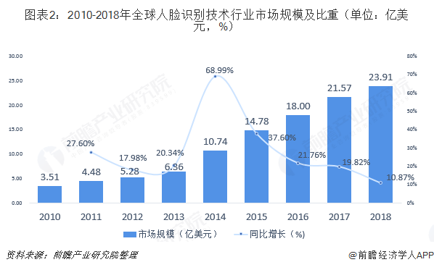
EER 3% 意味着什么？
正常情况下基本可用
对比人脸识别的经验，EER 3%意味着大规模应用的开端。
https://www.qianzhan.com/analyst/detail/220/190912-f3af58a3.html
LFW 上的人脸识别率
Zhou E, Cao Z, Yin Q. Naive-deep face recognition: Touching the limit of LFW benchmark or not?[J]. arXiv preprint arXiv:1501.04690, 2015.
Huang G B, Mattar M, Berg T, et al. Labeled faces in the wild: A database forstudying face recognition in unconstrained environments[C], Workshop on faces in'Real-Life'Images: detection, alignment, and recognition. 2008.

Slide 7
事实真的如此吗？
有哪些广泛应用的声纹验证系统？
有哪些声纹提供商没被客户埋怨过？
有哪些声纹厂商真正赚钱了？
.....
声纹识别的真实性能可能远比我们看到的要差...

Slide 8
Questionable Benchmarks
录音条件受控（设备、环境、姿态）
用户配合
有效session不足
发音特征与场景绑定^{[1]}
S. Shon and J. Glass, “Multimodal association for speaker verification,” in Proceedings of the Annual Conference of Internation_x0002_al Speech Communication Association (INTERSPEECH), 2020, pp.2247–2251.

Slide 9
CN-Celeb: 复杂场景声纹数据
名星语音，可搜集范围广
多场景，跨场景
多信道、多设备、多编码...
Fan Y, Kang J W, Li L T, et al. Cn-celeb: a challenging chinese speaker recognition dataset[C]//ICASSP 2020-2020 IEEE International Conference on Acoustics, Speech and Signal Processing (ICASSP). IEEE, 2020: 7604-7608.
Li L, Liu R, Kang J, et al. CN-Celeb: multi-genre speaker recognition[J]. arXiv preprint arXiv:2012.12468, 2020.

Slide 10
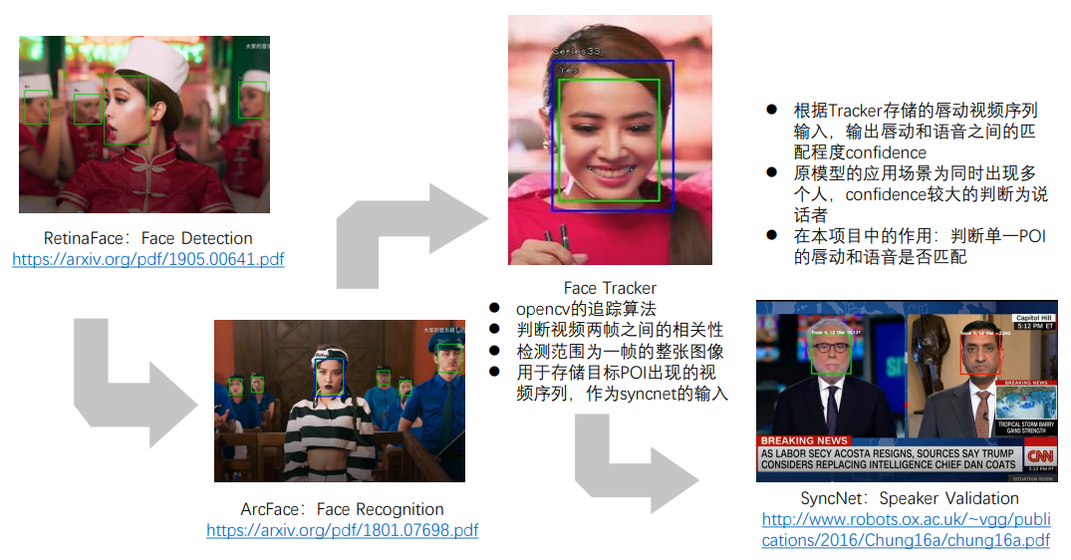
CN-Celeb: 复杂场景声纹数据
STEP 1: POI list design
STEP 2: Pictures and videos download
STEP 3: Face detection and tracking
STEP 4: Active speaker verification
STEP 5: Relax and recovery by speaker diarization
STEP 6: Human check
Toolkit: http://cslt.riit.tsinghua.edu.cn/mediawiki/index.php/CN-Celeb
Notes:
1、名人列表；2、下载图片和视频；3、人脸检测与追踪；4、口唇一致性检测；5、声纹识别二次确认；6、人工核查

Slide 11
CN-Celeb1 & CN-Celeb2

Slide 12
CNCeleb: Length distribution

Slide 13
CNCeleb: Genre distribution

Slide 14
CNCeleb: Cross-genre speakers

Slide 15
CNCeleb: Utt/Speaker distribution

Slide 16
CNCeleb: Session/Speaker distribution

Slide 17
CNCeleb: Pruning rate
Human Check很重要！

Slide 18
CNCeleb.E Test set

Slide 19
VoxCeleb baseline
Much worse performance on CN-Celeb test set!

Slide 20
VoxCeleb SOTA
Many advanced techniques simply overfit to the dataset.

Slide 21
CNCeleb.E on different genres

Slide 22
CNCeleb.E on cross genres

Slide 23
CNCeleb.E on cross genres

Slide 24
More information about CNCeleb
https://arxiv.org/pdf/2012.12468.pdf

Slide 25
当场景相对复杂时，当前主流声纹识别技术是无法满足实用要求的。

Slide 26
Statistical difference for different genres
Less discriminative and more variation with complex conditions.

Slide 27
Statistical difference for different genres
More domain mismatch with complex conditions.

Slide 28
Solution1: Multi-genre training
In-domain feature training does not offer much advantage
In-domain PLDA training is effective
No-cross-genre training works, though less effective than cross-genre training.

Slide 29
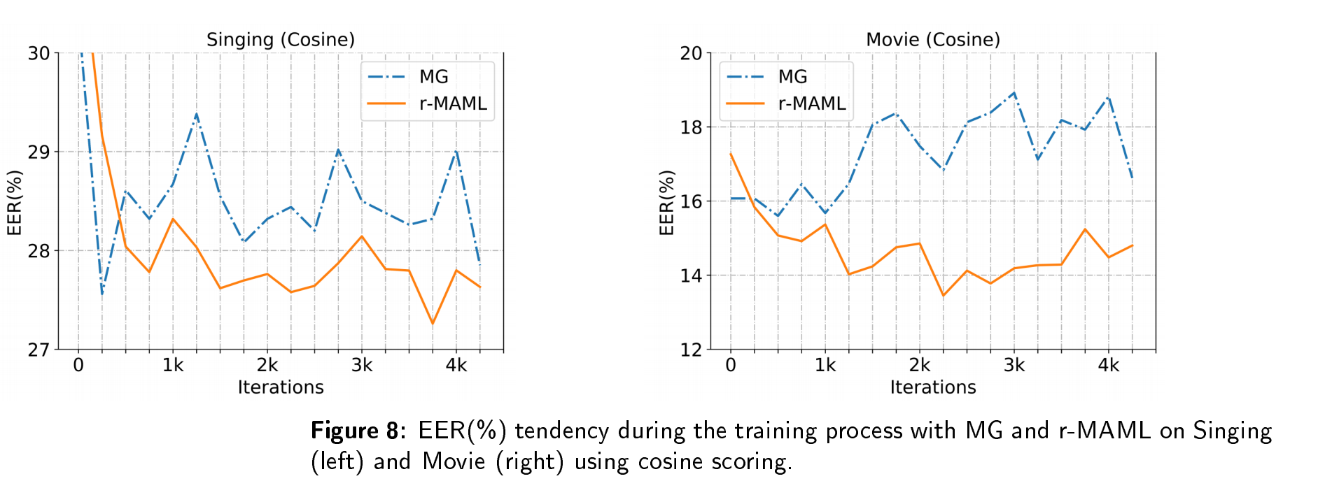
Solution2: Meta learning
Jiawen Kang,Ruiqi Liu,Lantian Li,Yunqi Cai,Dong Wang,Thomas Fang Zheng, "Domain-Invariant Speaker Vector Projection by Model-Agnostic Meta-Learning", Interspeech 2020.

Slide 30
Solution2: Meta learning

Slide 31
Solution3:Calibration
X-vector with/without calibration for each enrollment condition

Slide 32
Other solutions
Genre adversarial training
Inter-genre compensation
Unsupervised domain adaptation
Enrollment-test matching by statistics decomposition
…

Slide 33
Why multi/cross genre is so hard?

Slide 34

Why multi/cross genre is so hard?
It involve almost all the variations that we can think of
Variation that have been partially addressed: device, channel, recording distance, ambient noise and reverberation, speaking rate…
Variations that have not addressed much: speaking style, emotion…
It is almost the final step towards real applications.
However, can we complete this step?

Slide 35
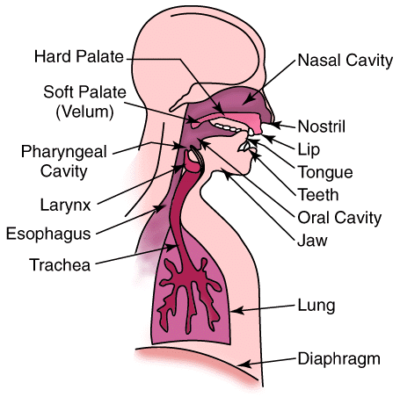
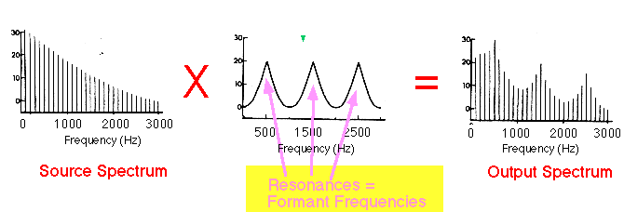
Question 1: Is the speaker trait Reliable?
Speaker trait is reflected in multiple stages of pronunciation.
Speaker trait is modulated by other factors, some are significant.
People can easily alternate their perceptual trait.
Ocinneide et al., Linear Prediction: The Problem, its Solution and Application to Speech, 2008.

Slide 36
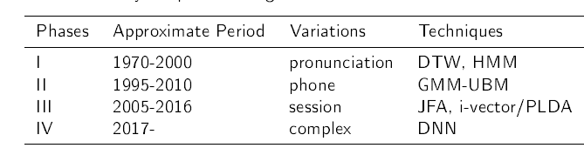
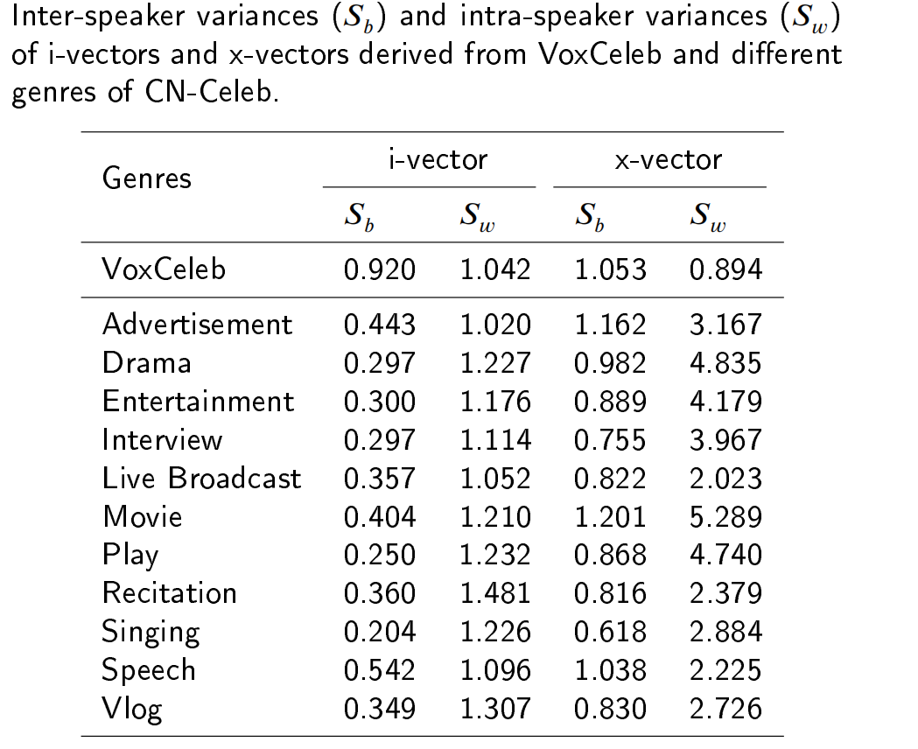
Question 1: Is the speaker trait Reliable?
Significant intra-speaker variation
The history of speaker recognition is a history of address intra-speaker variation

Slide 37
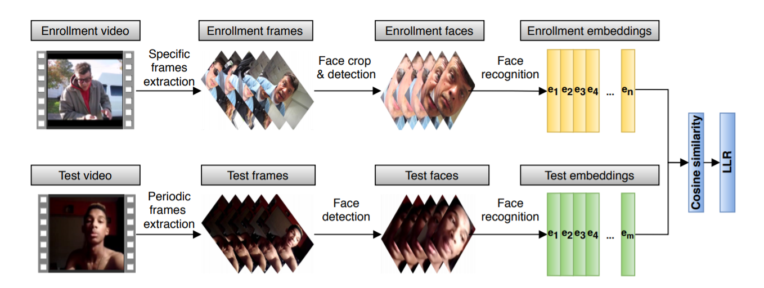
Question 2: Is speaker trait discriminative?
2019 NIST Multimedia SRE

Slide 38
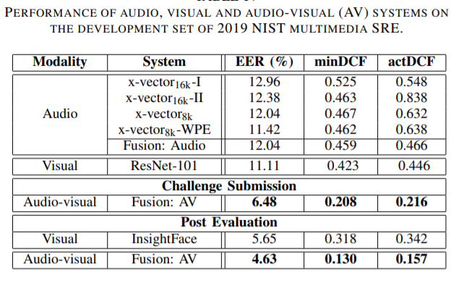
Question 2: Is speaker trait discriminative?
Kumar Das et al., HLT-NUS Submission for 2019 NIST Multimedia Speaker Recognition Evaluation, APSIPA 2020.

Slide 39
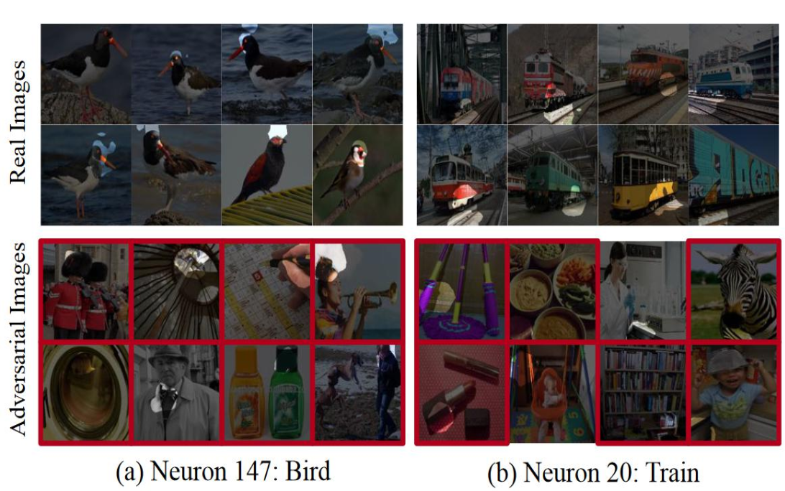
Question 3: Is speaker trait well represented?
Deep learning may learn fake patterns, e.g., style is regarded as speaker.
It immediately leads to weak generalization.
Dong Y P, Su H, Zhu J, et al. Towards interpretable deep neural networks by leveraging adversarial examples.In: Proceedings of the IJCAI workshop on AISC, Sydney, 2019.

Slide 40
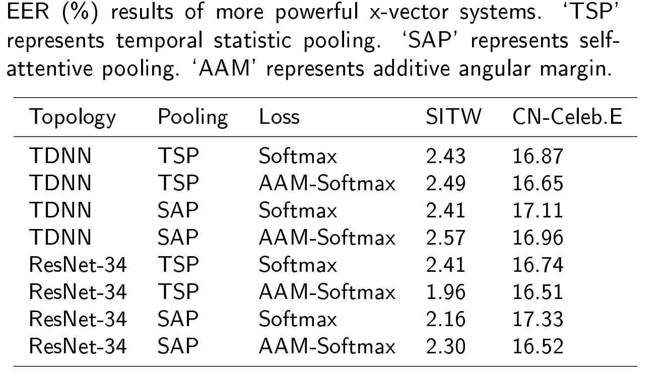
Question 3: Is speaker trait well represented?

Slide 41
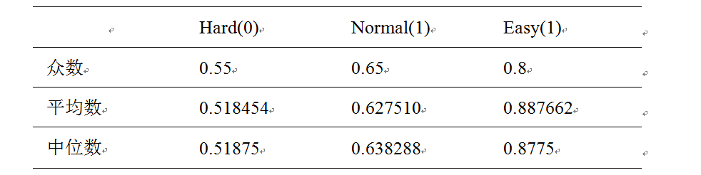
Question 4: Have machines tried their best?
We do not know, as the machine has done much better than human beings.

Slide 42
Conclusions
Although it works in controlled domain, caution must be paid to any wish of generalization with SV.
CNCeleb is a good benchmark to test the concerns related to the future of SV.

Slide 43
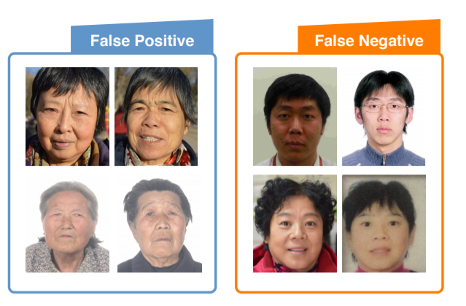
Lesson from face recognition
Megvii face recognition system uses simple model (CNN+softmax +PCA) but large data set (20k individual, 50 M photos), achieves 99.5% accuracy on LFW (like SITW).
When applied to Chinese ID benchmark, true positive rate 66% when false positive rate is 10⁻⁵.
Hesitation, suspicion, desperation, but finally they succeed.
Zhou E, Cao Z, Yin Q. Naive-deep face recognition: Touching the limit of LFW benchmark or not?[J]. arXiv preprint arXiv:1501.04690, 2015.

Slide 44
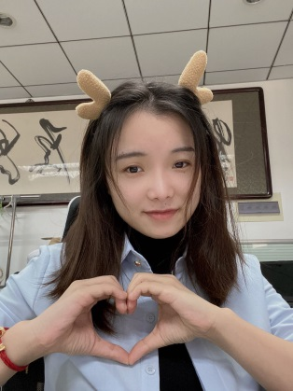
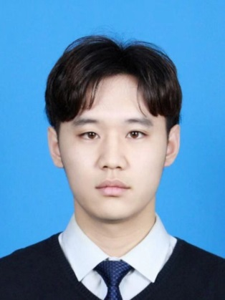
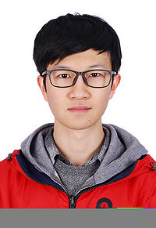
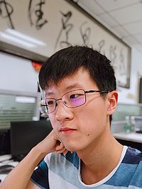
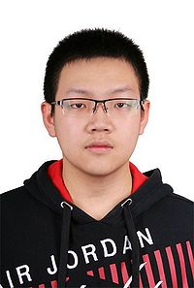

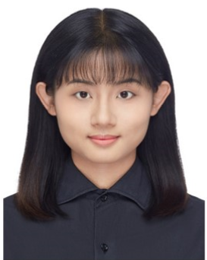
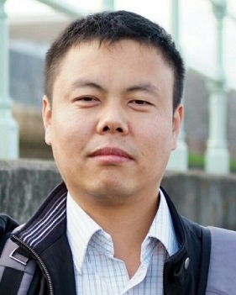
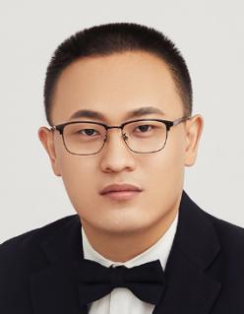
CN-Celeb团队
Yue Fan
Jiawen Kang
Kaicheng Li
Haolin Chen
Sitong Cheng
Pengyuan Zhang
Ziya Zhou
Dong Wang
Lantian Li

Slide 45

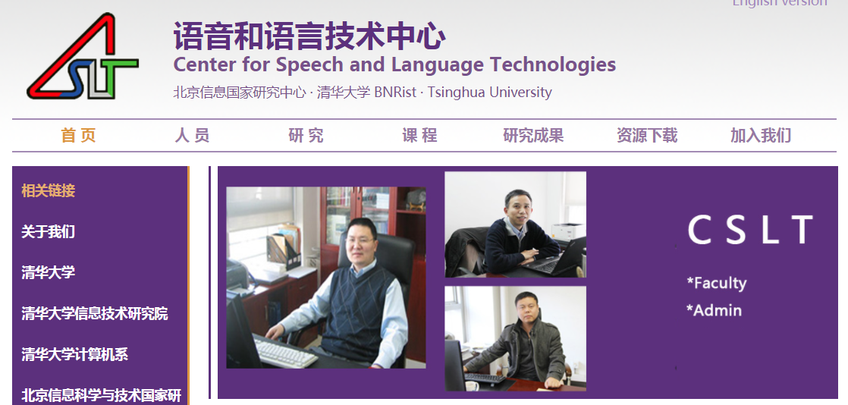


清华大学语音语言技术研究中心
http://cslt.riit.tsinghua.edu.cn

Slide 46

Join us !
Center for speech and language technologies (CSLT), BNRist at Tsinghua University, Beijing.
Postdoc fellow, Research engineer
Contact :
lilt@mail.tsinghua.edu.cn;
wangdong99@mails.tsinghua.edu.cn
Notes:
对我们研究方向感兴趣的小伙伴可以与我联系

Slide 47

AI光影社
http://www.airadiance.cn/

